Slide 1

Data Security and Anonymization

Slide 2
Introduction
Data security and privacy are paramount concerns in the digital age.
Organizations must protect individuals' data and comply with privacy regulations.
This project demonstrates data security and anonymization using PySparkSQL in Azure Databricks.
PySparkSQL allows efficient anonymization of large datasets.

Slide 3
Project Overview
The project aims to anonymize sensitive data in a sample dataset using PySparkSQL in Azure Databricks. The goal is to protect the privacy of individuals' information while ensuring compliance with privacy regulations.
Objectives: Generate sample dataset, anonymize data, save anonymized data to a new CSV file.

Slide 4
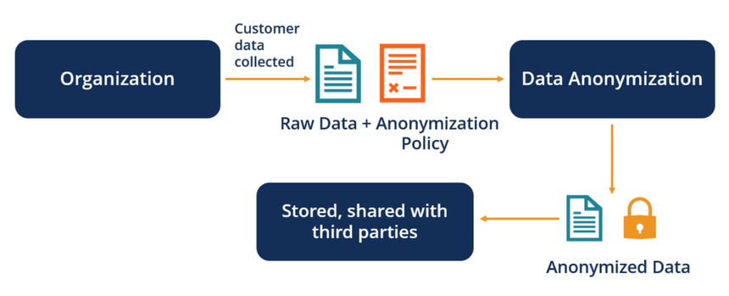
Architecture diagram

Slide 5
Azure Resources Used for this Project (Technologies/Tools Used):
Azure Databricks: A cloud-based analytics platform built on Apache Spark, providing a collaborative environment for data processing and anonymization.
PySparkSQL: The Python API for Spark SQL, allowing users to run SQL queries and manipulate data using DataFrame APIs.
Faker: A Python library for generating fake data like names, addresses, and phone numbers. Used to create a sample dataset for demonstration purposes.
Hashlib: A Python library offering cryptographic hashing functions. Used to hash sensitive data for anonymization.
Azure Storage: A cloud storage solution providing scalable, secure, and reliable storage for the source and anonymized data files.

Slide 6
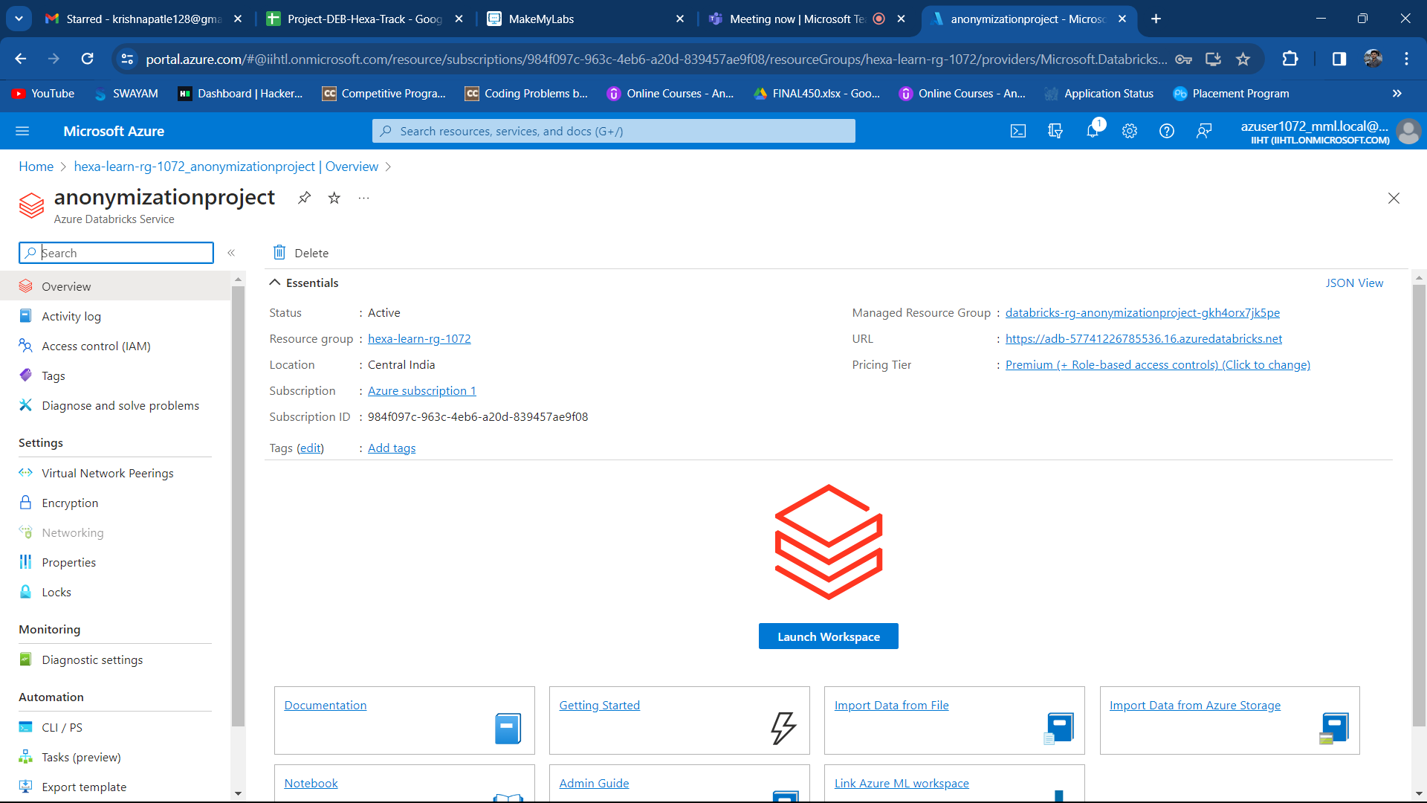
Execution Overview
Setting up Azure Databricks:
Create a workspace and set up Azure Storage for data storage.

Slide 7
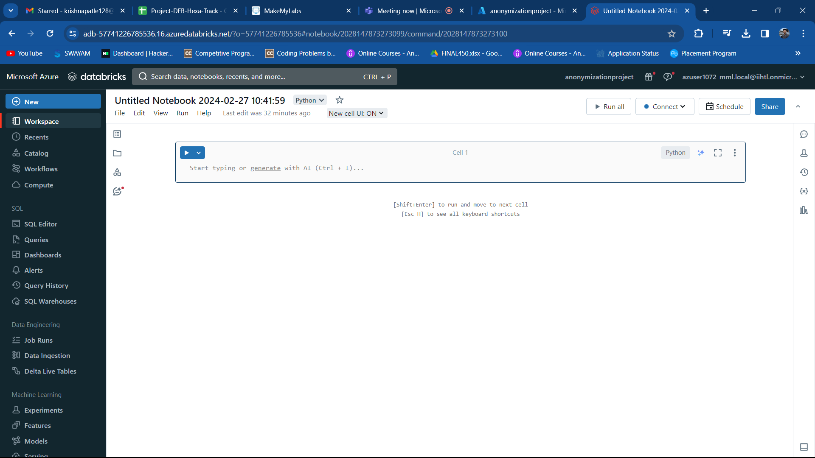
Developing PySpark Notebooks:
Create a PySpark notebook within the workspace to write PySpark code for data anonymization.

Slide 8
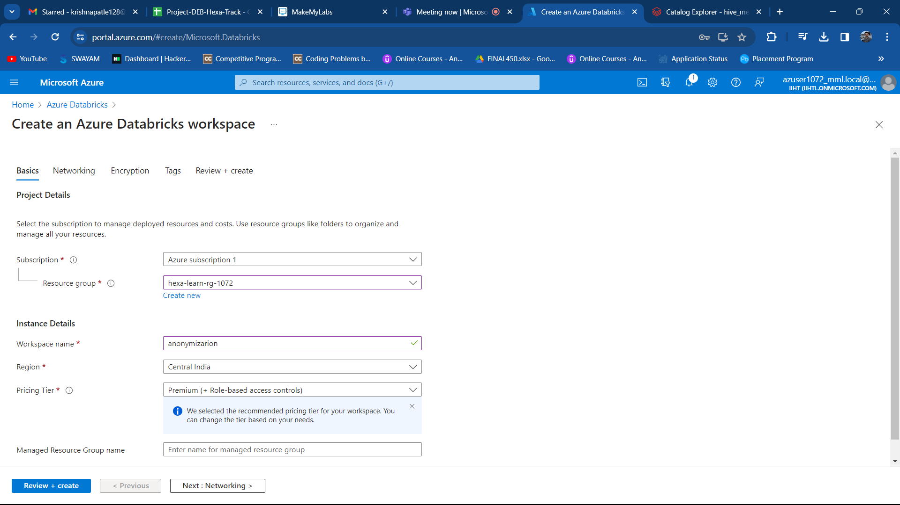
Creating a Cluster and Connecting to Notebook:

Slide 9
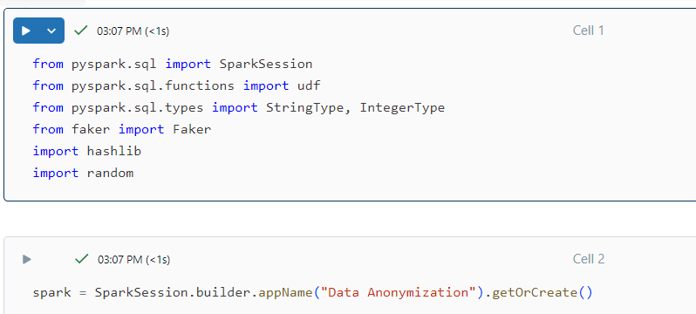
Importing Libraries and Creating a Spark Session:
Import necessary libraries and use SparkSession.builder to configure and create a SparkSession for data processing.

Slide 10
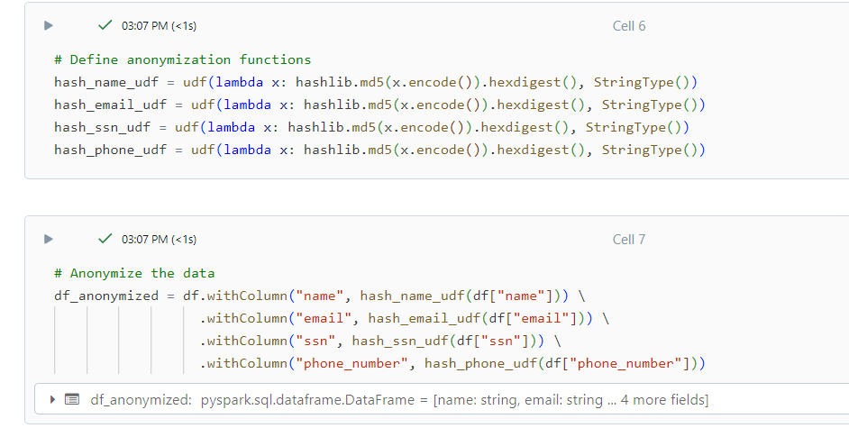
Generating Sample Data and Applying Anonymization:
Utilize Faker to generate a sample dataset with sensitive information.
Apply anonymization techniques like hashing to protect sensitive data points.

Slide 11
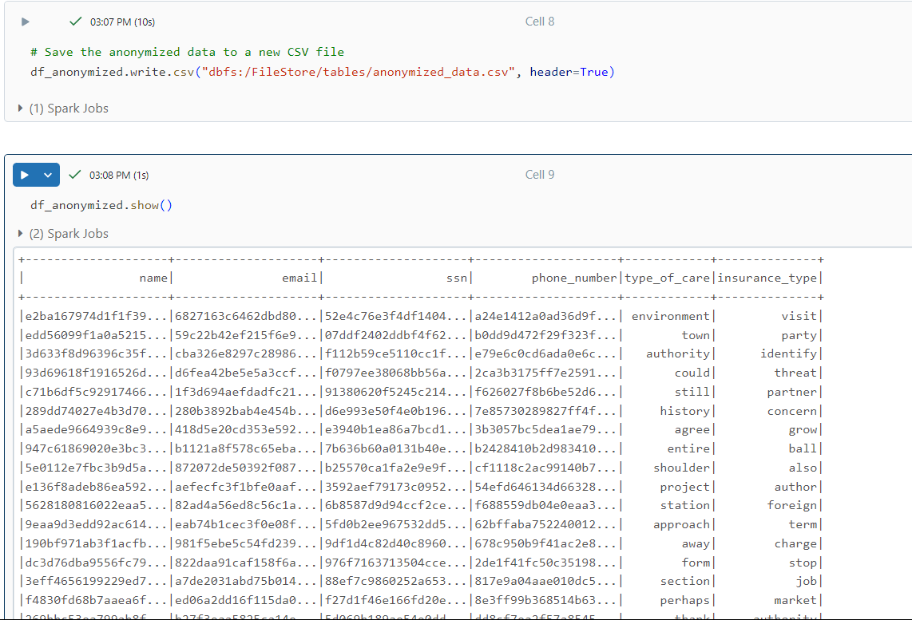
Saving the Output:
Save the anonymized data to a new CSV file.

Slide 12
Result:
The final outcome of this project is a new CSV file containing the anonymized dataset, where sensitive information like names, emails, and phone numbers have been masked using hashing techniques. Due to security and privacy concerns, screenshots of the anonymized data cannot be provided. However, you can verify successful anonymization by reviewing the output file to ensure sensitive data is no longer readily identifiable.

Slide 13
Conclusion:
By leveraging PySparkSQL in Azure Databricks, this project demonstrates how organizations can effectively anonymize sensitive data while maintaining compliance with privacy regulations. This approach safeguards sensitive information and ensures responsible data handling practices.

